Slide 1
Programmed IO for x86
Talking to Hardware with Code

Slide 2
What is “Programmed IO”?
Often, we control devices CPU program instructions (programmed IO).
Often on memory bus (“main” address space)
Sometimes on a data bus (separate address space)
Distinct from direct memory access (DMA), where device runs code
Typical x86 processors use both port-mapped IO (device memory is accessed via data bus “ports”) and memory-mapped IO (device memory resides at main memory addresses).

Slide 3
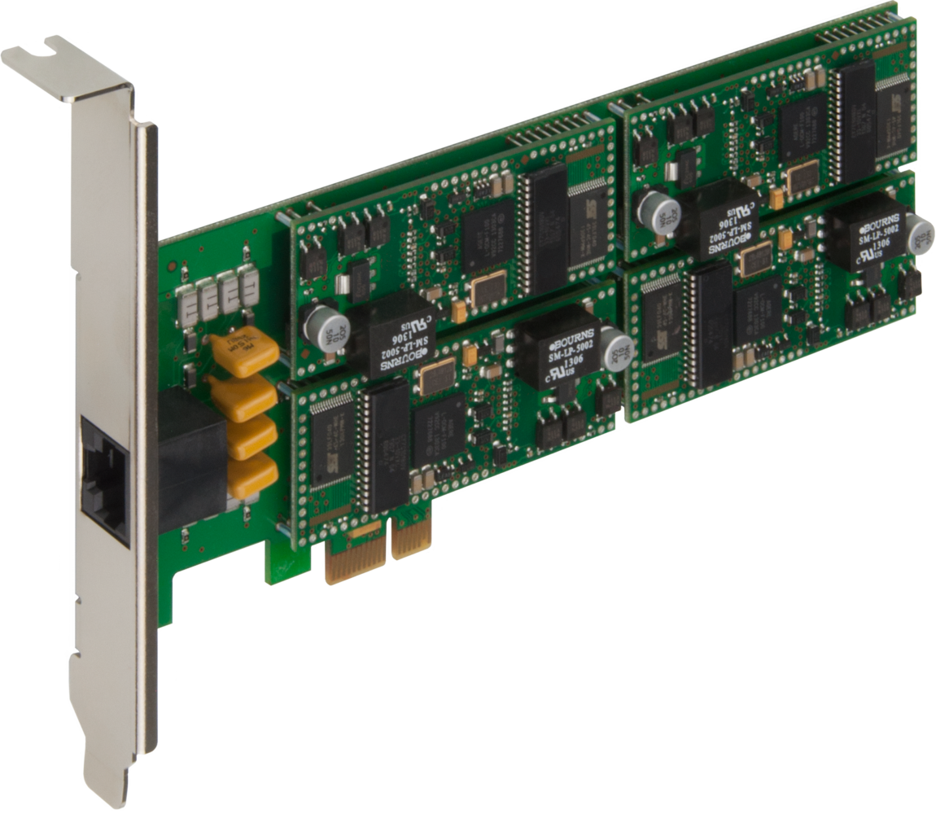



Device Memory Models
Programmed IO Model
Device Memory
CPU
CPU Read/Writes Device Memory
Memory Bus
DMA Model
Programs DMA Controller
Requests Transfer
Transfers Data to RAM
CPU
DMA Controller
Drive Controller
Main Memory
Storage
Interrupt #
Acknowledge

Slide 4
Memory Bus vs Data Bus
On x86 systems, there are two main ways to transmit information:
Address (memory) bus – same address space as system memory (RAM)
Data (IO) bus – distinct address space just for IO devices
These address spaces use distinct assembly instructions (MOV or IN/OUT) to route data to the correct device according to the system’s configuration. Some of these addresses are standardized (e.g., VGA and keyboard) while others vary by device (e.g., modems and sound cards).

Slide 5
BIOS Routines
Some architectures – notably x86 – provide BIOS “software interrupts”.
Routines “ready to go”, and space for more (usually replaceable)
Provide access to typical system functions (e.g., simple device drivers)
Like a system call, but more “low level” (direct hardware access, etc.)
For i836, system calls are actually invoked via “interrupt” 0x80!
Standard BIOS calls have been established input devices like the mouse, as well as typical output devices like monitors and other screens.
Note that all BIOS routines ultimately are just sets of normal instructions!

Slide 6
Anatomy of a BIOS Call
BIOS calls consist of a handler, function, parameters, & return values.
The function number and parameters (if any) are set.
The interrupt handler is invoked.
Return values (if any) can be retrieved.
Functions, parameters, and returns are standardized by register.
INT Example | Value | Meaning
Handler | 0x16 | Keyboard
Function | AH = 0x50 | Country Code
Parameter(s) | AL = 0x01 | Get Current Code
Return Register(s) | AL = Status (00 = success, 02 = error) BX = Country code
// EXAMPLE – FETCH KEYBOARD COUNTRY CODE
mov ah, 0x50 // Set function
mov al, 0x01 // Set Parameter(s)
int 0x16 // Invoke handler
// Country code can now be fetched from BX.

Slide 7
Video Graphics Adapter Setup
Step 1: Set the Video Mode.
Set Video Mode | Value | Meaning
Handler | 0x10 | Video
Function | AH = 0x00 | Set Mode
Parameter(s) | AL = Mode | New Mode
Return(s) | AL = Status (BIOS dependent)
Mode | Description
0x00 | Text: 40x25 (Low-Res)
0x03 | Text: 80x25 (High-Res)
0x12 | Graphics: 640x480 (16 Colors)
0x13 | Graphics: 320x200 (256 Colors)
Step 2: If in MCGA mode, Set the Palette.
write_data(PORT, DATA):
mov dx, PORT // set port
mov al, DATA // set data
out dx, al // execute write
set_palette:
write_data(0x03C6, 0xFF) // Set color mask to “anything” (no mask)
write_data(0x03C8, 0x00) // Tell VGA to update palette color 0
write_data(0x03C9, 0x3F) // Set RED component to 63 (max)
write_data(0x03C9, 0x3F) // Set GREEN component to 63 (max)
write_data(0x03C9, 0x00) // Set BLUE component to 0 (min)
Data Port | Write Register | Range
0x03C6 | Palette Mask | 0x00–0xFF
0x03C7 | Read Color Index | 0x00–0xFF
0x03C8 | Write Color Index | 0x00–0xFF
0x03C9 | RGB Data | 0x00–0x3F
Neat trick: change the palette rapidly for a fading effect!

Slide 8
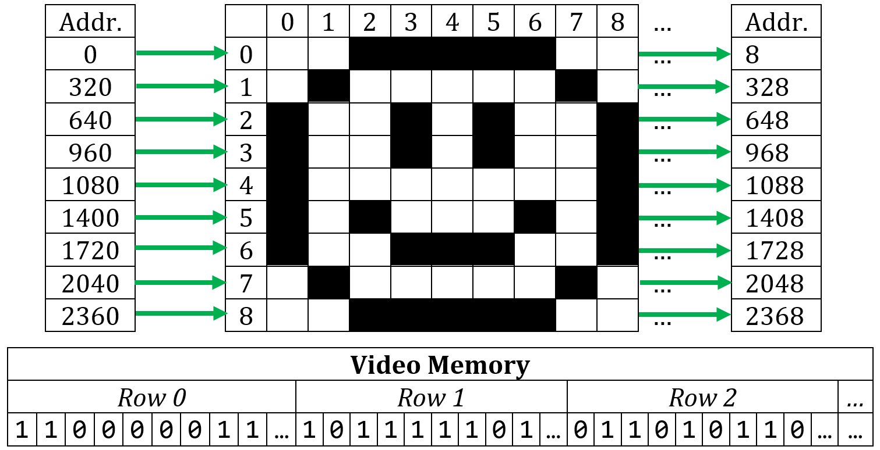
VGA: Memory Layout
Video memory is just a fancy array in address range 0x0A0000:0x0BFFFF.
In MCGA mode, each pixel is the index to a color in the palette.

Slide 9
VGA: Vertical Synchronization
It is good practice to draw between vertical retraces to avoid “tearing” by starting writes just after the beginning of a new retrace.
// C/C++ version
#include <conio.h>
void waitForRetrace()
{
while (inp(0x3DA) & 0x08);
while (!inp(0x3DA) & 0x08);
writePixelsToVRAM();
}
Retrace Drawing
While vertical trace is less critical for LED, it is important for CRTs, and modern hardware may mimic older patterns for compatibility.

Slide 10
Programmed IO: Mouse Example
While exact data format varies by device, mice deliver information about…
Button presses (1+ buttons)
Button releases (1+ buttons)
Movement magnitude (2 axes)
Movement sign / direction (2 axes)
Mouse movement is returned in mickeys (about 127 µm or 0.005 inches), which can be converted into screen position (e.g., “8 x-mickeys per x-pixel”).

Slide 11


Processing Hardware State
To update a character device (e.g., mouse) state, we do the following:
Start from the current state (buttons up/down, X/Y location)
Treat data stream as event buffer, applying data to update current state
Reserve any unprocessed / incomplete stream elements for “later”
Current
Data Reserve
New Data
New
Data Reserve
X-Mickeys: +5
Y-Mickeys: -3
X-Mickeys: +24
Y-Mickeys: -10
Left P/R: 0/1
Right P/R: 1/0
X-Mickeys: +13
Y-Mickeys: -5
X: 16 mickeys/px
5,10
Y: 8 mickeys/px
6,9

